Slide 1
Jadex BDI Agents Integrated with MATSim for Autonomous Mobility on Demand
Marcel Mauri (mauri@cs.uni-frankfurt.de)
Ömer Ibrahim Erduran (erduran@cs.uni-frankfurt.de)
Mirjam Minor (minor@cs.uni-frankfurt.de)
Department of Business Information Systems
Goethe University Frankfurt, Germany
EMAS 2024
Notes:
My name
It is a joint project with
The topic is

Slide 2
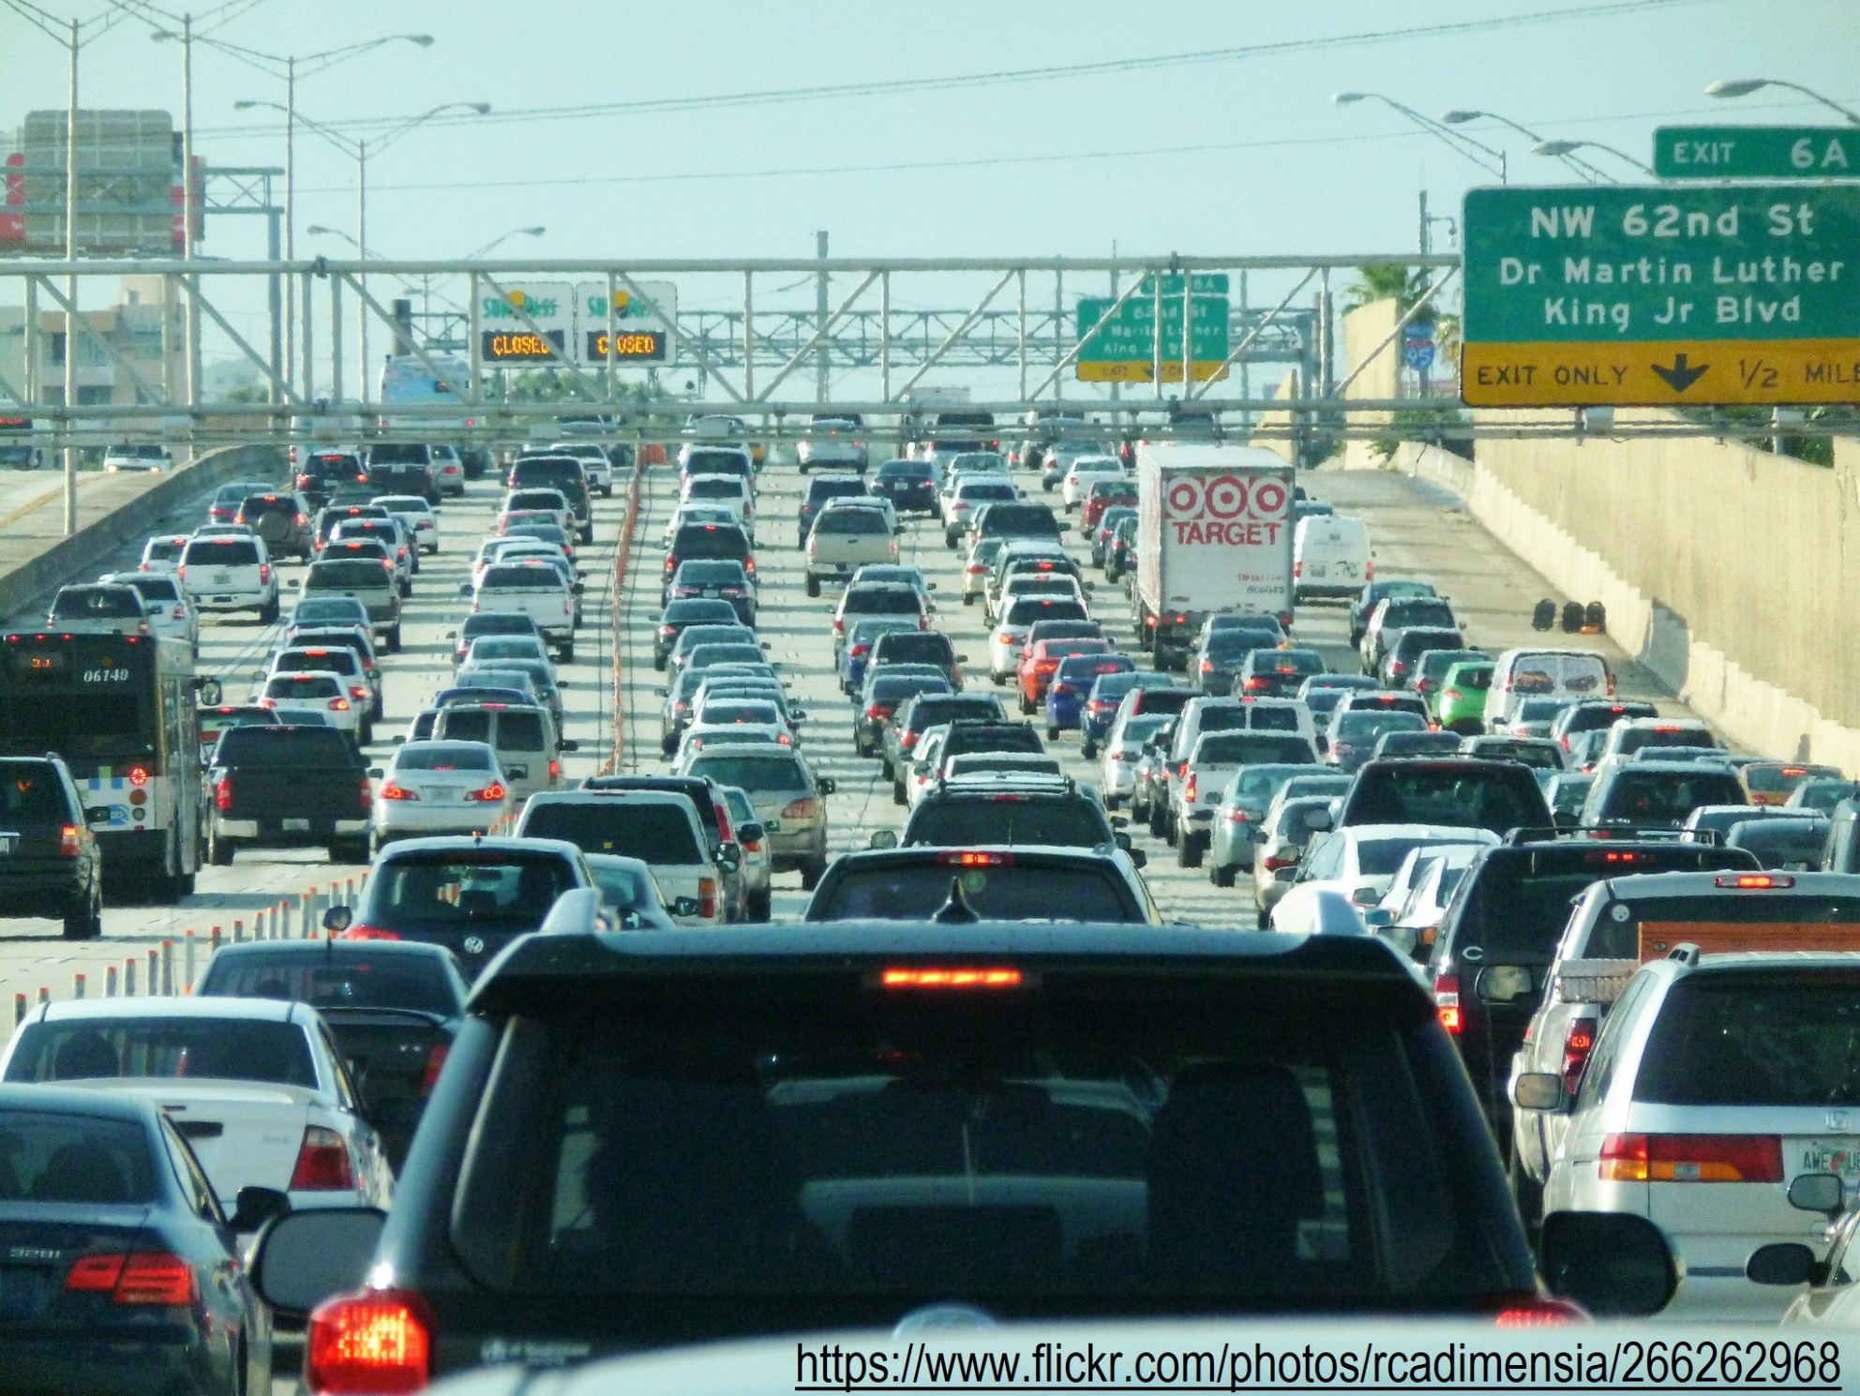
Motivation
Unlocking Tomorrow's Transportation: The Power of Cognitive SW-Agents
Managing road traffic and sustainable mobility are global challenges
Large-scale Agent-based technology can contribute to reduce emissions
Simulation and better decision-making in multi-modal mobility

Slide 3
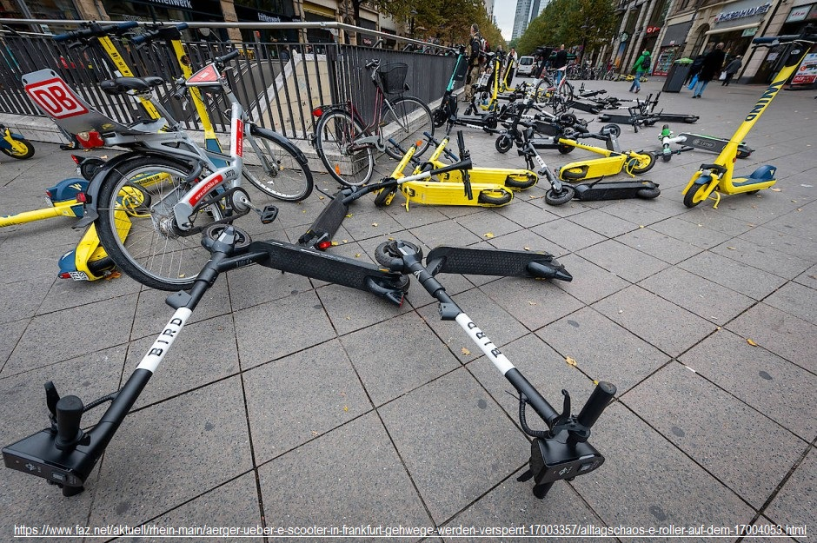
Motivation
Mobility as a Service (MaaS): buying mobility services as packages based on
consumers’ needs instead of buying the means of transport [Kamargianni et al., 2016]
Autonomous Mobility on Demand (AMoD): contains a fleet of autonomous Vehicles that pick up
passengers and transport them to their destination [Bazzan et al., 2024, Malas et al., 2016]
Notes:
Some types of MaaS have disadvantages. For example the bikes and scooters in the cities which can become dangerous abstacles
A way to overcome this could be Autonomous Mobility on Demand

Slide 4
Our aim
An integrated MAS framework with reasoning-simulation capabilities for AMoD scenarios
Contributions:
1. Vehicle Agent Architecture:
Platform: Jadex, Jade, Jill, Jason,…
BDI→ multiple actions at the same time
Learning and Planning integratable
Portable to other platforms
Proven technology
2. Jadex-MATSim connection layer:
traffic simulation: MATSim, Sumo,…
Large-scale
Rich Output data in open formats
Notes:
We also need
We want to test our agents by processing available historical data from various mobillity services
With these we can work out the advantages of our agents and are able to compare it
with different other solutions
Agent development frameworks
+ allow complex agents (fullfil all of our requirements)
- limited simulation capabilities
Simulation platforms
+ complex simulations
- only very simple agents supported (if any)

Slide 5
Related work
Idea: Integrating SW-Agent Platform and Traffic Simulation for Mobility on Demand
[Singh et al., 2016] → Our contribution builds on top of this
→Jadex Integration is deprecated, does not work with MATSim
Integration of Jade & SUMO [Garyan et al., 2023] → No Ride Sharing Application
Contract Net Protocol (CNP) for transportation: [Fischer et al., 1996] & [Dorer and Calisti, 2005]
Notes:
MATSIM: Discrete Event Based Simulation
SUMO: Continuous Simulation
MATSIM: Large-Scale Fleet Simulation, providing MoD functionalities
SUMO: Microscopic Simulation
MATSIm: Java, XML
SUMO: C++
the design of self-managing vehicle agents for AMoD applications following
the BDI paradigm and using the contract net protocol to negotiate workloads
among themselves.
2. the synchronization between a BDI agent development framework and a traffic
simulation platform building upon the results of Singh et al. [34].

Slide 6

Intended behaviour of the MAS
New Trip
a₁
4
2
5
a₃
a₂
1
a₄
a₅
a₆
3
Notes:
Want to give an overview of the behaviour of the vehicle agents
The MAS we designed consists of different types of agents which i want to show you in this example
The area of operation is divided into several sub-areas, for each of them there is an responsible area agent.
And there are several vehicle agents
When a customer orders a new trip
It will be sent to the responsible area agent
we will take a closer look at area agent 2

Slide 7
Delegating Jobs with the CNP
Closest agent
Calculating utility
Request neighbours
Starting CNP
1. Announcement
2. Bidding
3. Awarding
2
5
a₂
1
Notes:
area agent 2 will now select the vehicle agent which is located closest to the customer (KLICK)
Then this vehicle agent will calculate a utillity score based of a utillity function
This score will determine how suitable the agent
In this case we asume that
1. Announce
2. They will send their own utiliity scores
3. Vehicle agent 2 will then select the best suited vehicle agent for the job

Slide 8
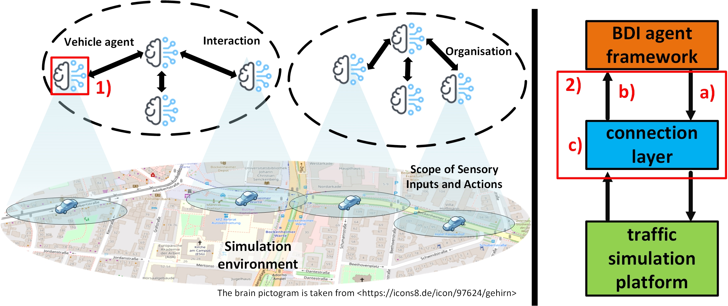
BDI Agent Framework and Simulation Platform
Notes:
Here you can see an overview of our project
Our contribution consists of two parts
First we have designed a multi agent system with a agent development framework
The MAS consists of of multiple groups of vehicle agents
Every brain represents vehicle agent
the agents inside of every groups in are interacting with each other

Slide 9
BDI Agent Framework and Simulation Platform
Notes:
Besides that agent development framework we will also use a traffic simulation platform
The agents in the BDI agent Framework are literaly the brains
The simulation platform have also agents here represented by the cars
But these agents are very simple and will just act as the bodies of our brains
So every brain is assigned to a body
Brain gives commands
Body executes the comands and returns the information it senses in invironment

Slide 10
BDI Agent Framework and Simulation Platform
Notes:
To connect the BDI agent framework with the traffic simulation platform we need a connection layer.
Build upon the results of Singh who developed a framework called BDI-ABM which can connect ADF and Simulation platforms.
We designed and implementation a connection layer for the synchronization between BDI agents and traffic simulation platform.

Slide 11
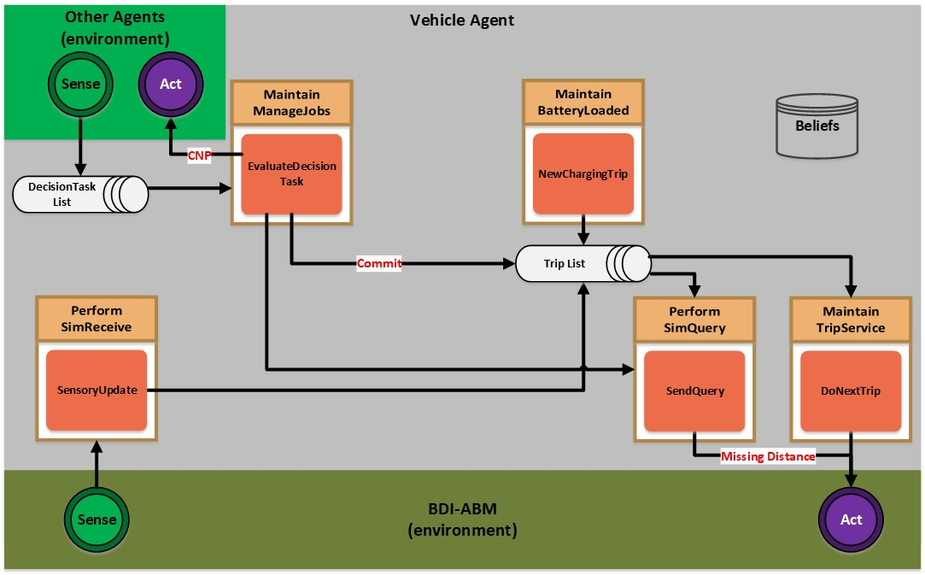
Vehicle Agent Architecture
Notes:
Closer look into one of our vehicle agents implemented with Jadex
In this Detailed Architecture
Left corner we have the environment consisting of the other agents
Other agents send customer requests
DecisionTaskList
Maintain ManageJobs process all
Evaluate Decision Task
We have different types of Goals and their corresponding Plans (Maintain goals)
Delegate
Utilliy Function
Example before it can be delegated when low

Slide 12
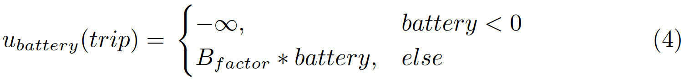
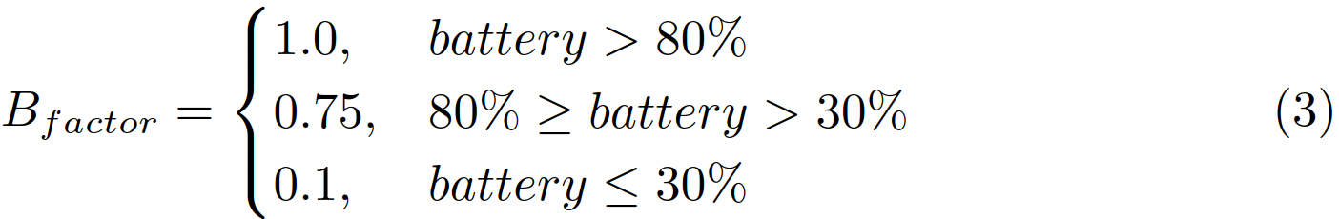
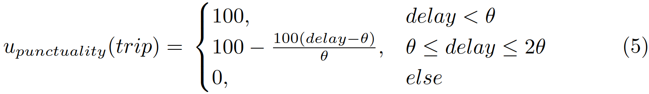
Vehicle Agent Architecture
$$u\left(trip\right)=u_{distance}\left(trip\right)+u_{battery}\left(trip\right)+u_{punctuality}\left(trip\right)$$
Notes:
Utilliy Function
first approach
definitely improvable
3 components
Distance: expected starting point from where it will drive to the customer
Battery: expected battery level after doing the trip B factor (make sure)
Punctuality estimate the delay the agent will arrive at the customer Theta

Slide 13
Vehicle Agent Architecture
Notes:
When there will be a high utillity score
Trip list
Scheduled
MaintainBatteryloaded + Plan NewChargingTrip
Also Triplist

Slide 14
Vehicle Agent Architecture
Notes:
Maintain TripService + DoNextTrip
BDI-ABM environment (our connection layer) to the simulation platform
PerformSim Receive + SensoryUpdate
Perform SimQuery + SendQuery
Not jet implemented
Will request the exaxt route the vehicle will drive on the simulation site
Right now the agent can not consider the street network for ist evluations

Slide 15
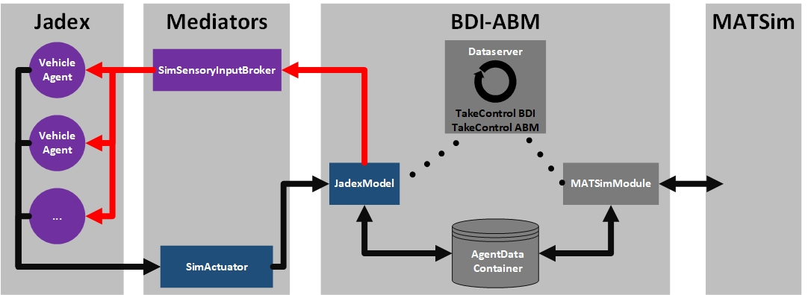
Jadex-MATSim connection layer
Notes:
This is a more detailed illustration of our connection layer
The greyed out components where taken over from the already existing BDI-ABM framework.
BDI-ABM was already able to communicate mit MATSim but not together with jadex
There was a suppert for an ancient version of jadex but it would only work with repast
Our version based on the connection to the existing Jill framework
AgentDataContainer
Purple (Jadex agent) needed if you want to write informations into an jadex agent
Our Modell allows the vehicle agents to carrie out other actins like … independently of the cycle

Slide 16
Hypotheses
H1 The customer satisfaction (ODR) increases due to the capability to negotiate and delegate trips via CNP.
H2 The Average Travel Distance (ATD) per satisfied customer remains stable despite negotiation.
H3 Fewer agents are required to do the work due to negotiation.
The order dropout rate ODR measures the rate of trip requests that have been Dropped.
The average travel distance ATD measures the average travel distance to serve a trip.

Slide 17

Experimental Data
Data set from a German Bike Sharing Company containing rental data of the University Campus
3 distinct subsets, each representing a day of bike rental (1000 Trip requests per set)
Single trip request is defined as:
→Trip ID, Trip Type, Desired Start Time, Geolocations of Start and End
Dataset coordinates of Trip requests manipulated from station based rental to free float coordinates
Unfortunately, no usable purely free-float open source data available

Slide 18

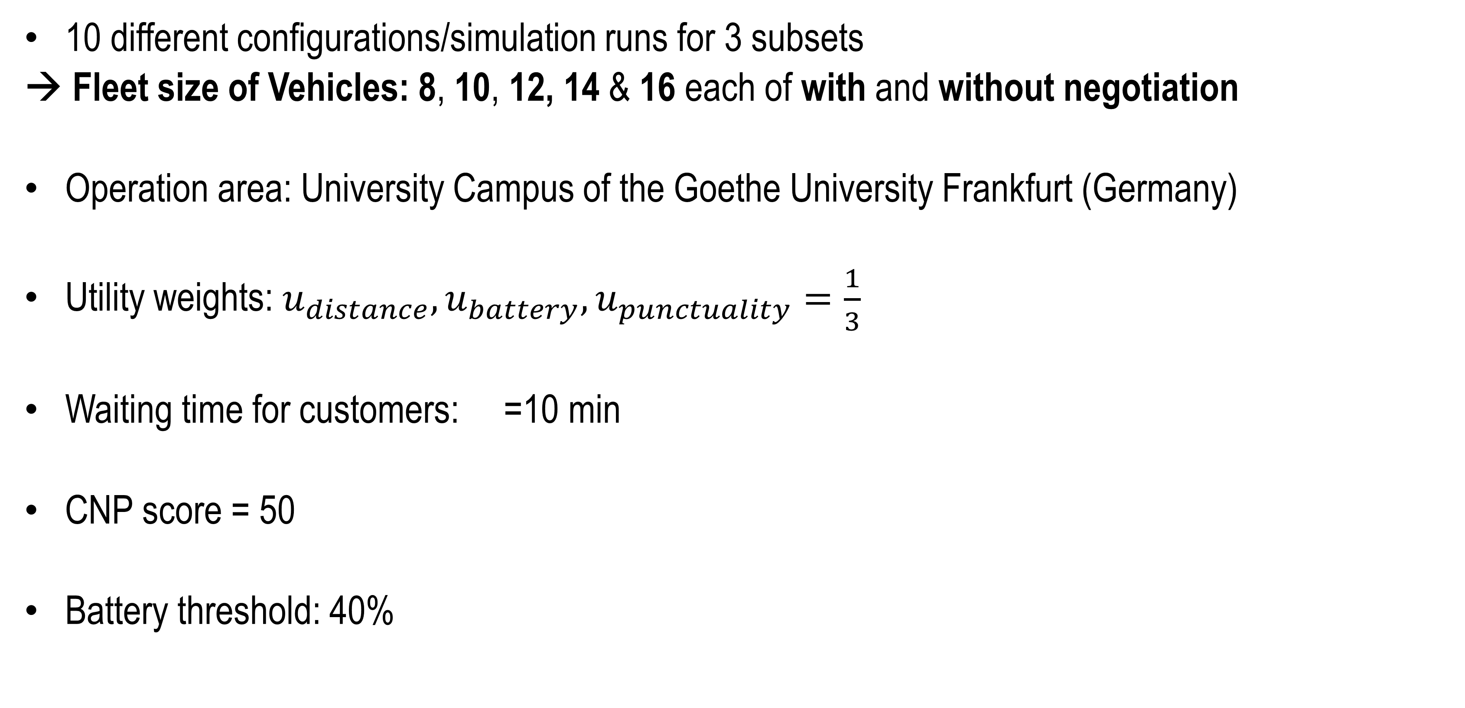
Experimental Runs
10 different configurations/simulation runs for 3 subsets
→ Fleet size of Vehicles: 8, 10, 12, 14 & 16 each of with and without negotiation
Operation area: University Campus of the Goethe University Frankfurt (Germany)
Utility weights: $u_{distance}, u_{battery}, u_{punctuality}=\frac{1}{3}$
Waiting time for customers: =10 min
CNP score = 50
Battery threshold: 40%

Slide 19
Results
config | served trips | missed trips | charging trips | ODR
nearest₈ | 748 | 252 | 161 | 25.2%
with neg₈ | 826 | 174 | 160 | 17.4%
nearest₁₀ | 804 | 196 | 258 | 19.6%
with neg₁₀ | 875 | 125 | 253 | 12.5%
nearest₁₂ | 252 | 139 | 239 | 13.9%
with neg₁₂ | 910 | 86 | 227 | 8.6%
nearest₁₄ | 881 | 125 | 245 | 12.5%
with neg₁₄ | 934 | 61 | 234 | 6.6%
nearest₁₆ | 893 | 89 | 235 | 8.9%
with neg₁₆ | 961 | 44 | 228 | 4.4%
config | total distance (meters) | served trips | ATD (meters)
nearest₈ | 1,442,185 | 748 | 1,928
with neg₈ | 1,535,585 | 826 | 1,859
nearest₁₀ | 1,461,647 | 804 | 1,815
with neg₁₀ | 1,522,737 | 875 | 1,740
nearest₁₂ | 1,467,224 | 852 | 1,722
with neg₁₂ | 1,500,483 | 910 | 1,649
nearest₁₄ | 1,452,130 | 881 | 1,648
with neg₁₄ | 1,483,613 | 934 | 1,588
nearest₁₆ | 1,454,333 | 893 | 1,629
with neg₁₆ | 1,454,542 | 961 | 1,514
Table 1: Order Dropout Rate (ODR)
Table 2: Average Travel Distance (ATD)
H1: The customer satisfaction increases due to negotiation and delegation of Trips via CNP.
H2: The ATD per satisfied customer remains stable despite negotiation.
H3: Fewer agents are required to do the work due to negotiation.

Slide 20
Results
config | served trips | missed trips | charging trips | ODR
nearest₈ | 748 | 252 | 161 | 25.2%
with neg₈ | 826 | 174 | 160 | 17.4%
nearest₁₀ | 804 | 196 | 258 | 19.6%
with neg₁₀ | 875 | 125 | 253 | 12.5%
nearest₁₂ | 252 | 139 | 239 | 13.9%
with neg₁₂ | 910 | 86 | 227 | 8.6%
nearest₁₄ | 881 | 125 | 245 | 12.5%
with neg₁₄ | 934 | 61 | 234 | 6.6%
nearest₁₆ | 893 | 89 | 235 | 8.9%
with neg₁₆ | 961 | 44 | 228 | 4.4%
config | total distance (meters) | served trips | ATD (meters)
nearest₈ | 1,442,185 | 748 | 1,928
with neg₈ | 1,535,585 | 826 | 1,859
nearest₁₀ | 1,461,647 | 804 | 1,815
with neg₁₀ | 1,522,737 | 875 | 1,740
nearest₁₂ | 1,467,224 | 852 | 1,722
with neg₁₂ | 1,500,483 | 910 | 1,649
nearest₁₄ | 1,452,130 | 881 | 1,648
with neg₁₄ | 1,483,613 | 934 | 1,588
nearest₁₆ | 1,454,333 | 893 | 1,629
with neg₁₆ | 1,454,542 | 961 | 1,514
Table 1: Order Dropout Rate (ODR)
Table 2: Average Travel Distance (ATD)
H1: The customer satisfaction increases due to negotiation and delegation of Trips via CNP.
H2: The ATD per satisfied customer remains stable despite negotiation.
H3: Fewer agents are required to do the work due to negotiation.

Slide 21
Results
config | served trips | missed trips | charging trips | ODR
nearest₈ | 748 | 252 | 161 | 25.2%
with neg₈ | 826 | 174 | 160 | 17.4%
nearest₁₀ | 804 | 196 | 258 | 19.6%
with neg₁₀ | 875 | 125 | 253 | 12.5%
nearest₁₂ | 252 | 139 | 239 | 13.9%
with neg₁₂ | 910 | 86 | 227 | 8.6%
nearest₁₄ | 881 | 125 | 245 | 12.5%
with neg₁₄ | 934 | 61 | 234 | 6.6%
nearest₁₆ | 893 | 89 | 235 | 8.9%
with neg₁₆ | 961 | 44 | 228 | 4.4%
config | total distance (meters) | served trips | ATD (meters)
nearest₈ | 1,442,185 | 748 | 1,928
with neg₈ | 1,535,585 | 826 | 1,859
nearest₁₀ | 1,461,647 | 804 | 1,815
with neg₁₀ | 1,522,737 | 875 | 1,740
nearest₁₂ | 1,467,224 | 852 | 1,722
with neg₁₂ | 1,500,483 | 910 | 1,649
nearest₁₄ | 1,452,130 | 881 | 1,648
with neg₁₄ | 1,483,613 | 934 | 1,588
nearest₁₆ | 1,454,333 | 893 | 1,629
with neg₁₆ | 1,454,542 | 961 | 1,514
Table 1: Order Dropout Rate (ODR)
Table 2: Average Travel Distance (ATD)
H1: The customer satisfaction increases due to negotiation and delegation of Trips via CNP.
H2: The ATD per satisfied customer remains stable despite negotiation.
H3: Fewer agents are required to do the work due to negotiation.

Slide 22
Results
config | served trips | missed trips | charging trips | ODR
nearest₈ | 748 | 252 | 161 | 25.2%
with neg₈ | 826 | 174 | 160 | 17.4%
nearest₁₀ | 804 | 196 | 258 | 19.6%
with neg₁₀ | 875 | 125 | 253 | 12.5%
nearest₁₂ | 252 | 139 | 239 | 13.9%
with neg₁₂ | 910 | 86 | 227 | 8.6%
nearest₁₄ | 881 | 125 | 245 | 12.5%
with neg₁₄ | 934 | 61 | 234 | 6.6%
nearest₁₆ | 893 | 89 | 235 | 8.9%
with neg₁₆ | 961 | 44 | 228 | 4.4%
config | total distance (meters) | served trips | ATD (meters)
nearest₈ | 1,442,185 | 748 | 1,928
with neg₈ | 1,535,585 | 826 | 1,859
nearest₁₀ | 1,461,647 | 804 | 1,815
with neg₁₀ | 1,522,737 | 875 | 1,740
nearest₁₂ | 1,467,224 | 852 | 1,722
with neg₁₂ | 1,500,483 | 910 | 1,649
nearest₁₄ | 1,452,130 | 881 | 1,648
with neg₁₄ | 1,483,613 | 934 | 1,588
nearest₁₆ | 1,454,333 | 893 | 1,629
with neg₁₆ | 1,454,542 | 961 | 1,514
Table 1: Order Dropout Rate (ODR)
Table 2: Average Travel Distance (ATD)
H1: The customer satisfaction increases due to negotiation and delegation of Trips via CNP.
H2: The ATD per satisfied customer remains stable despite negotiation.
H3: Fewer agents are required to do the work due to negotiation.

Slide 23
Future Work
better visualization for analysis (heatmaps, zones, larger experiments)
integration of Machine Learning algorithms (Neuro-symbolic Agents)
make the agents decisions explainable for „customers“
investigation of ride-hailing scenarios with different configurations
test the applicability of the framework for other application scenarios like ride-pooling and waste collection by a fleet of trucks
Notes:
What we have done so far are just the basic requiremens for intereesting stuff
How the decisions were made

Slide 24
Summary
An integrated MAS framework with reasoning-simulation capabilities for AMoD scenarios
Contributions:
1. Vehicle Agent Architecture:
Designed and implemented BDI Jadex agents with CNP
2. Jadex-MATSim connection layer:
Successfully extended the BDI-ABM Framework
Promising experimental results:
lower ODR
ATD remains stable

Slide 25
Questions?

Slide 26
References
[1] Kamargianni, M., Li, W., Matyas, M., and Schäfer, A. (2016). A Critical Review of New Mobility Services for Urban Transport. Transportation Research Procedia, 14:3294–3303.
[2] A. L. Bazzan, F. Klügl, A review on agent-based technology for traffic and transportation, The Knowledge Engineering Review 29 (2014) 375–403.
[3] A. Malas, S. E. Falou, M. E. Falou, M. Itmi, A. Cardon, Solving on-demand transport problem through negotiation, in: Proceedings of the Summer Computer Simulation Conference, 2016, pp. 1–7.
[4] Sadeghi Garjan, M., Chaanine, T., Pasquale, C., Paolo Pastore, V., Ferrando, A.:Agamas: A new agent-oriented traffic simulation framework for sumo. In: Malvone,V., Murano, A. (eds.) Multi-Agent Systems. pp. 396–405. Springer Nature Switzerland, Cham (2023)
[5] Dorer, K., Calisti, M.: An adaptive solution to dynamic transport optimization. p.45–51. AAMAS ’05, Association for Computing Machinery, New York, NY, USA (2005)
[6] Singh, D., Padgham, L., Logan, B.: Integrating BDI Agents with Agent-Based Simulation Platforms. Autonomous Agents and Multi-Agent Systems 30(6), 1050–1071 (2016)
Notes:
[2] https://www.flickr.com/photos/rcadimensia/26626296803
[3] https://www.faz.net/aktuell/rhein-main/aerger-ueber-e-scooter-in-frankfurt-gehwege-werden-versperrt-17003357/alltagschaos-e-roller-auf-dem-17004053.html

Slide 27
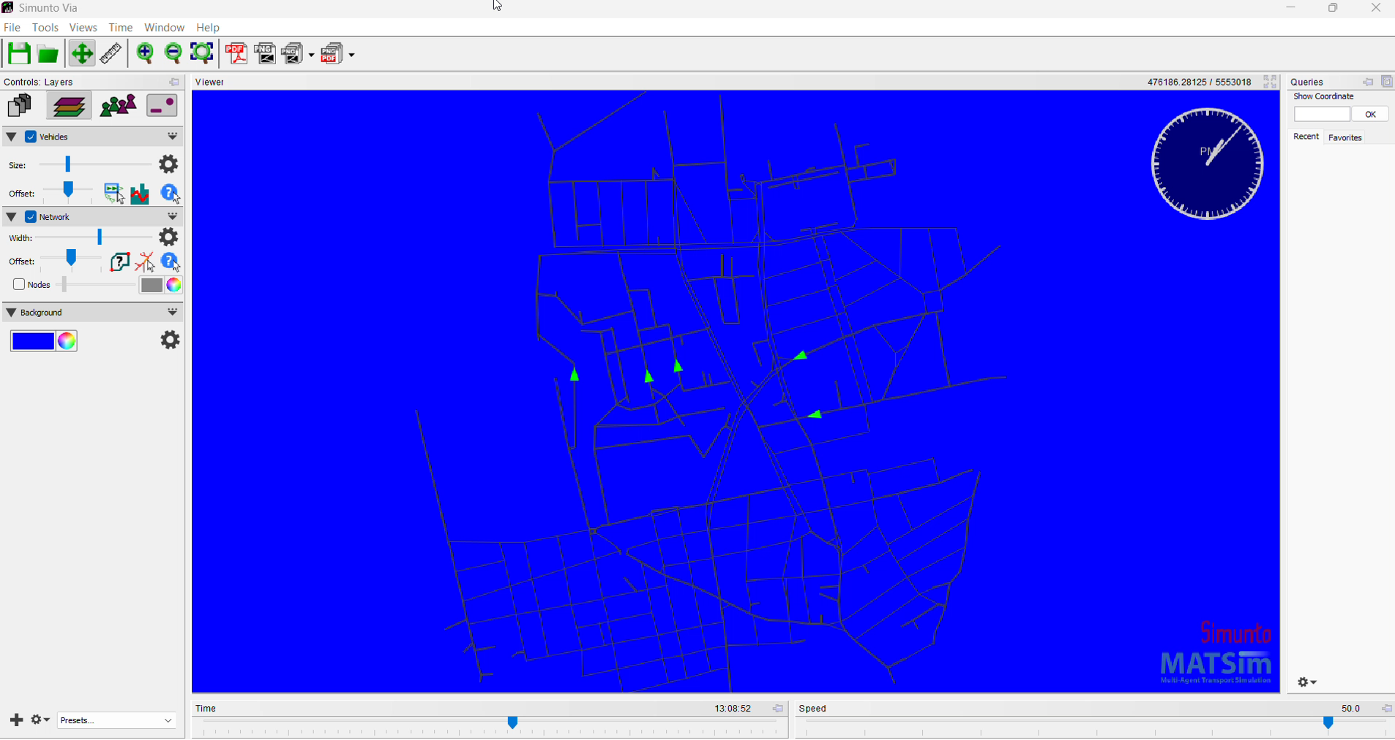
Simulation Visualization

